Slide 1
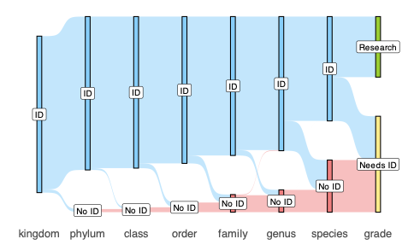
modelling
n = 998054
n = 1511334

